Slide 1

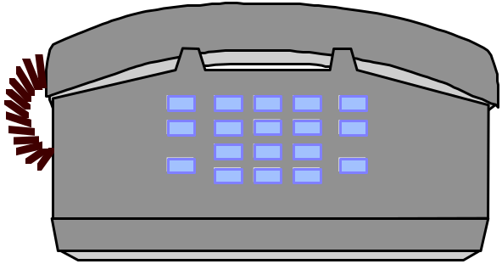
Searching an Array: Binary Search
Binary search is like looking up a phone number or a word in the dictionary
  Start in middle of book
  If name you're looking for comes before names on page, look in first half
  Otherwise, look in second half
Notes:
End of Lecture 38

Slide 2
Lecture No.39
Data Structure
Dr. Sohail Aslam

Slide 3
Binary Search
If ( value == middle element )
value is found
else if ( value < middle element )
search left-half of list with the same method
else
search right-half of list with the same method
Notes:
Start lecture 39

Slide 4
Binary Search
Case 1: val == a[mid]
val = 10
low = 0, high = 8
mid = (0 + 8) / 2 = 4
a:
1
5
7
9
10
10
13
17
19
27
0
1
2
3
4
5
6
7
8
low
mid
high

Slide 5
Binary Search -- Example 2
Case 2: val > a[mid]
val = 19
low = 0, high = 8
mid = (0 + 8) / 2 = 4
new low = mid+1 = 5
a:
1
5
7
9
10
13
13
17
17
19
19
27
27
0
1
2
3
4
5
6
7
8
low
new low
high
mid

Slide 6
Binary Search -- Example 3
Case 3: val < a[mid]
val = 7
low = 0, high = 8
mid = (0 + 8) / 2 = 4
new high = mid-1 = 3
a:
1
1
5
5
7
7
9
9
10
13
17
19
27
0
1
2
3
4
5
6
7
8
low
new high
mid
high

Slide 7
Binary Search -- Example 3 (cont)
val = 7
a:
1
5
7
9
10
13
17
19
27
0
1
2
3
4
5
6
7
8
a:
1
5
7
9
10
13
17
19
27
0
1
2
3
4
5
6
7
8
a:
1
5
7
9
10
13
17
19
27
0
1
2
3
4
5
6
7
8

Slide 8
Binary Search – C++ Code
int isPresent(int *arr, int val, int N)
{
int low = 0;
int high = N - 1;
int mid;
while ( low <= high ){
mid = ( low + high )/2;
if (arr[mid]== val)
return 1; // found!
else if (arr[mid] < val)
    low = mid + 1;
else
high = mid - 1;
}
return 0; // not found
}

Slide 9
Binary Search: binary tree
An entire sorted list
First half
Second half
First half
Second half
First half
The search divides a list into two small sub-lists till a sub-list is no more divisible.

Slide 10
Binary Search Efficiency
After 1 bisection N/2 items
After 2 bisections N/4 = N/2² items
. . .
After i bisections N/2^{i} =1 item
i = log₂ N

Slide 11
Implementation 3: linked list
TableNodes are again stored consecutively (unsorted or sorted)
insert: add to front; (1or n for a sorted list)
find: search through potentially all the keys, one at a time; (n for unsorted or for a sorted list
remove: find, remove using pointer alterations; (n)
key
entry
and so on

Slide 12
Implementation 4: Skip List
Overcome basic limitations of previous lists
  Search and update require linear time
Fast Searching of Sorted Chain
Provide alternative to BST (binary search trees) and related tree structures. Balancing can be expensive.
Relatively recent data structure: Bill Pugh proposed it in 1990.

Slide 13
Skip List Representation
Can do better than n comparisons to find element in chain of length n
head
tail
20
30
40
50
60

Slide 14
Skip List Representation
Example: n/2 + 1 if we keep pointer to middle element
head
tail
20
30
40
50
60

Slide 15
Higher Level Chains
head
level 1&2 chains
tail
20
26
30
40
50
57
60
For general n, level 0 chain includes all elements
level 1 every other element, level 2 chain every fourth, etc.
level i, every 2^{i} th element

Slide 16
Higher Level Chains
head
level 1&2 chains
tail
20
26
30
40
50
57
60
Skip list contains a hierarchy of chains
In general level i contains a subset of elements in level i-1

Slide 17
Skip List: formally
A skip list for a set S of distinct (key, element) items is a series of lists S₀, S₁ , … , S_{h} such that
  Each list S_{i} contains the special keys +∞ and −∞
  List S₀ contains the keys of S in nondecreasing order
  Each list is a subsequence of the previous one, i.e.,
  S₀ ⊇ S₁ ⊇ … ⊇ S_{h}
  List S_{h} contains only the two special keys
Notes:
End of lecture 39, Start of lecture 40.

